Slide 1

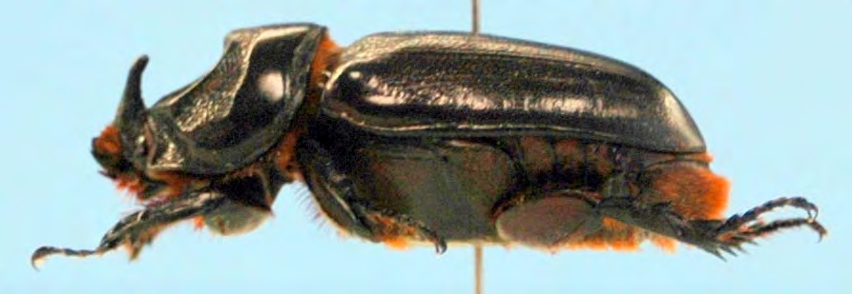



The coconut rhinoceros beetle invasion of Guam:
An unprecedented disaster
Aubrey Moore
Roland J. Quitugua
Trevor A. Jackson
Sean D.G. Marshall
Matthew Siderhurst
International Congress of Entomology, Orlando, Florida, Sept. 26, 2016

Slide 2
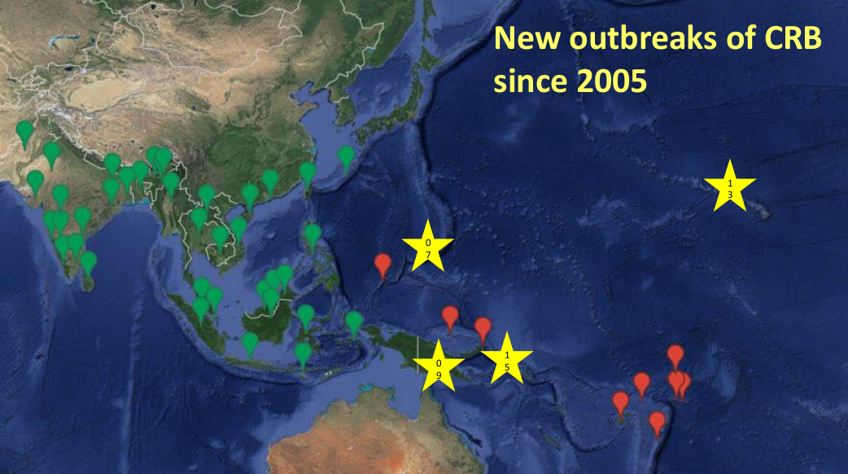
Notes:
- native range is SE Asia
- CRB arrived in the South Pacific with shipments of rubber plants from Ceylon
to Samoa in the early 1900s
- arrived in Palau during WWII
- no range expansion between 1975 and 2007
- only 1 successful eradication out of several attempts

Slide 3
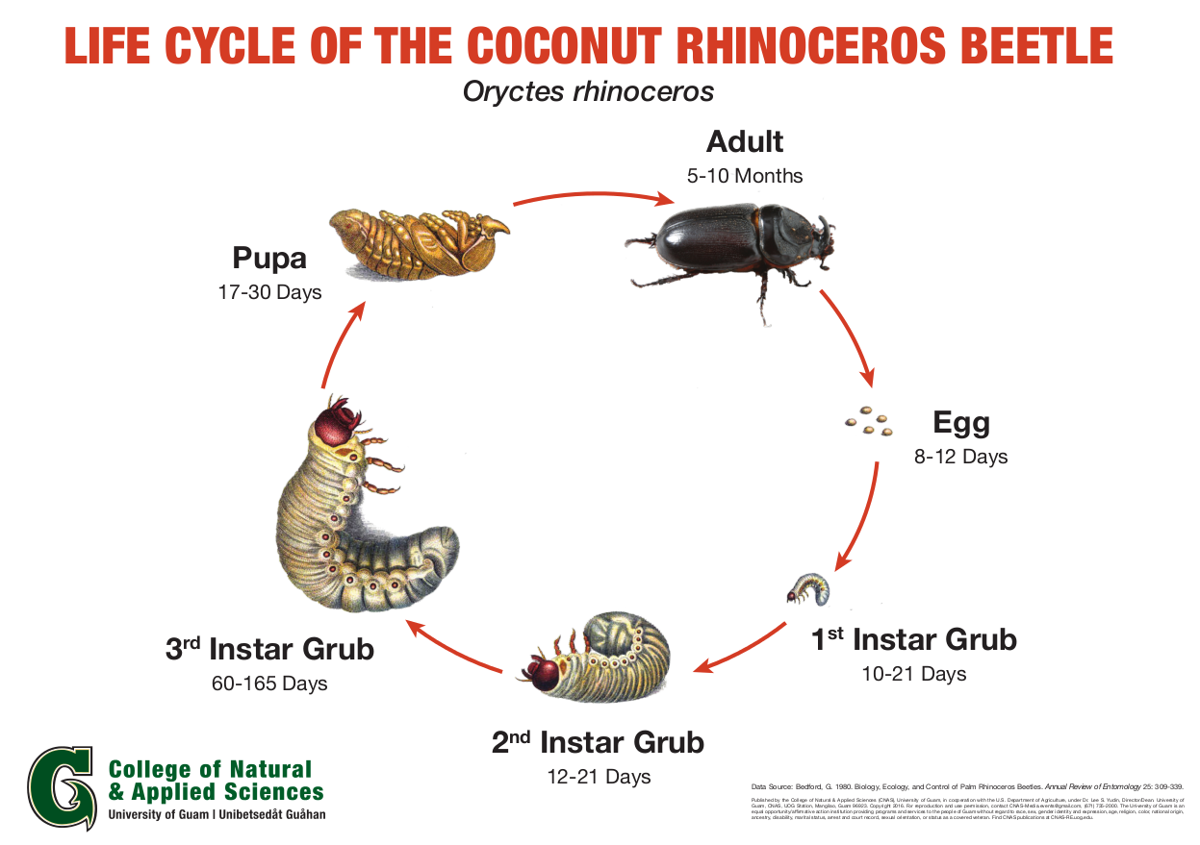

Slide 4
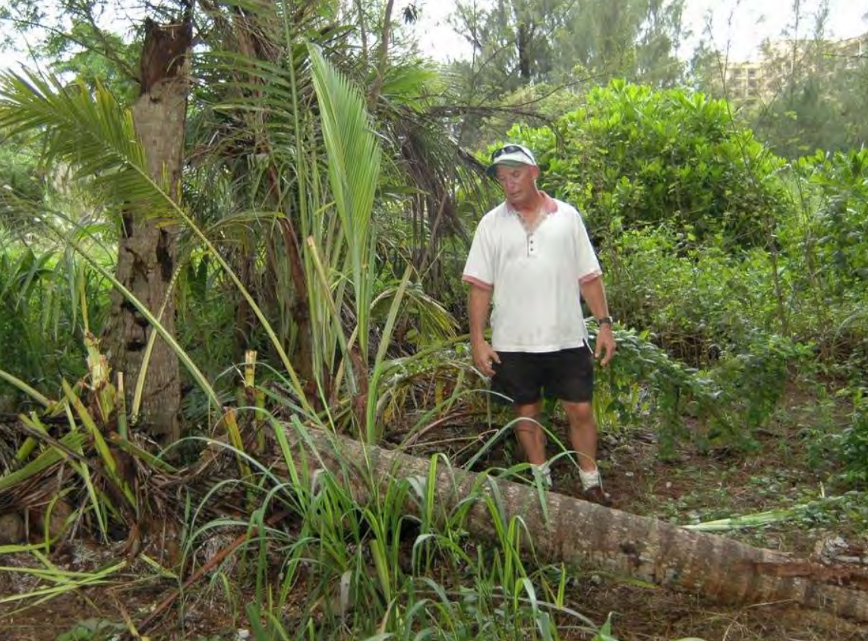

Slide 5
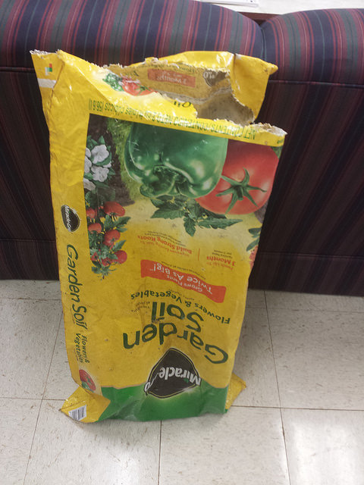
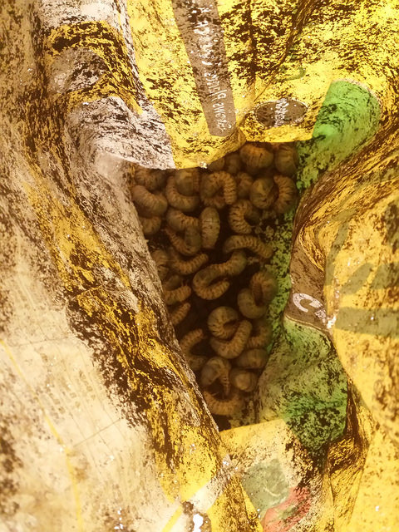

Slide 6
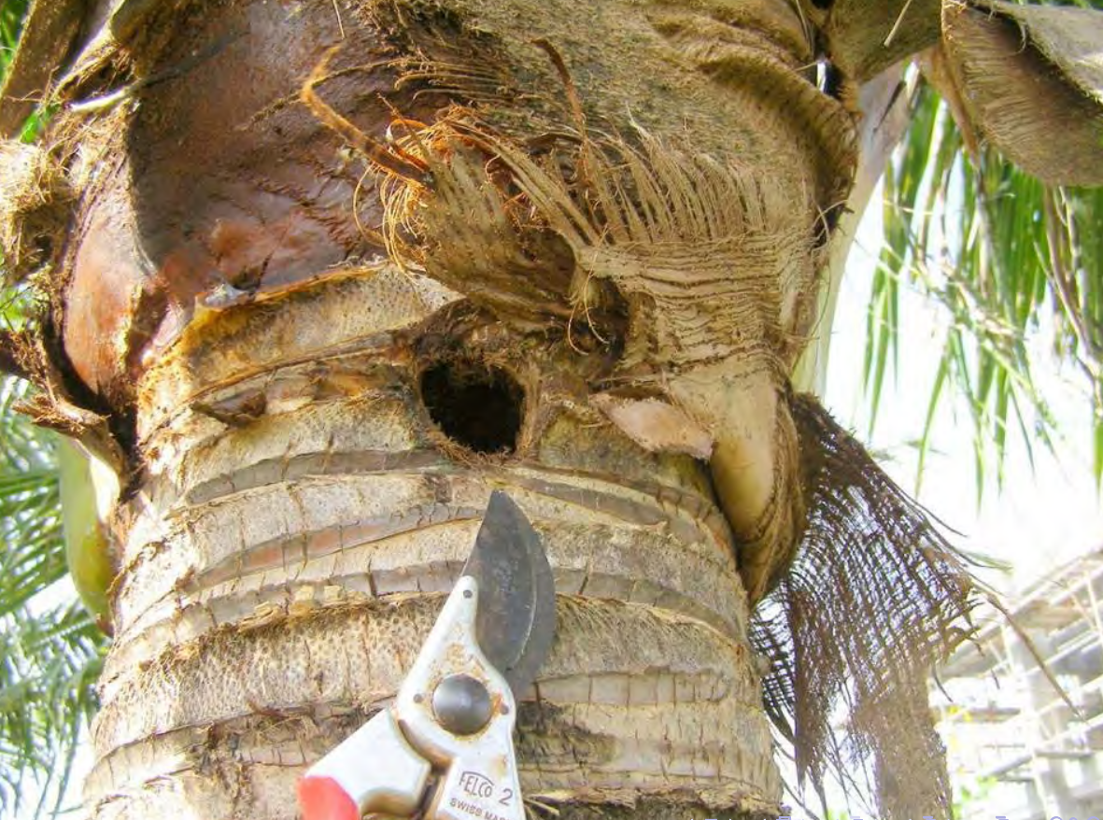
Notes:
- Adults bore into crowns of coconuts or other palms to feed on sap.
- Adults leave the bore hole after 2 or 3 days.
- Adults feed several times.
- Developing fronds are damaged when a beetle bores through them.
- Palms are killed if the meristem is damaged.
- Palms may regrow a full canopy of CRB damage is stoped. However, bore holes
do not heal, leaving palm structurally week and succeptible to beheading
strong winds.

Slide 7
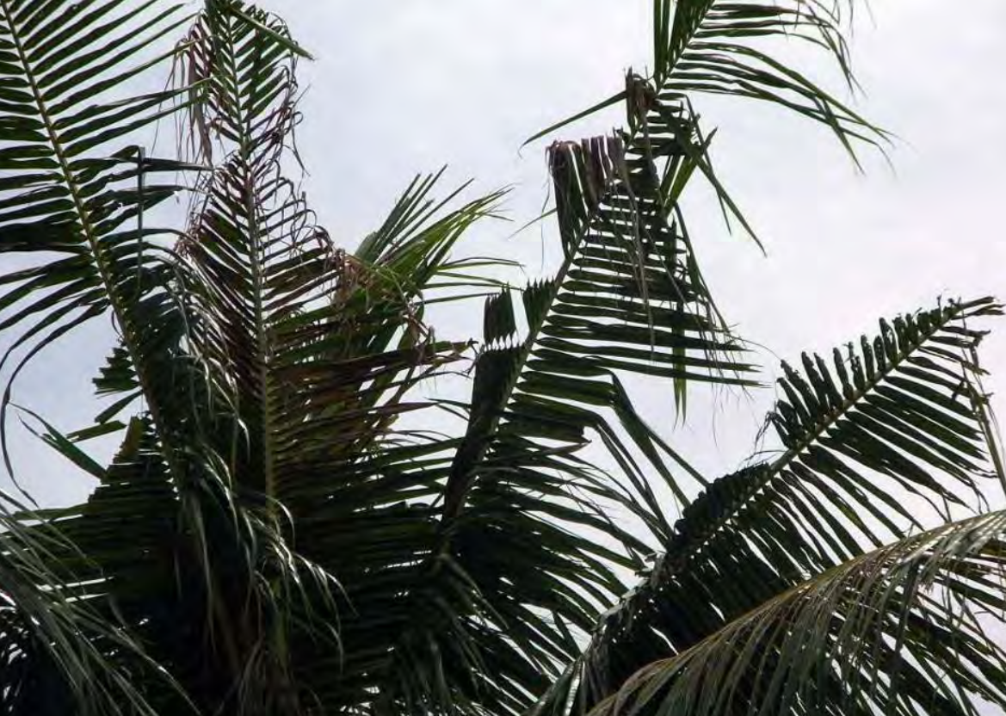

Slide 8
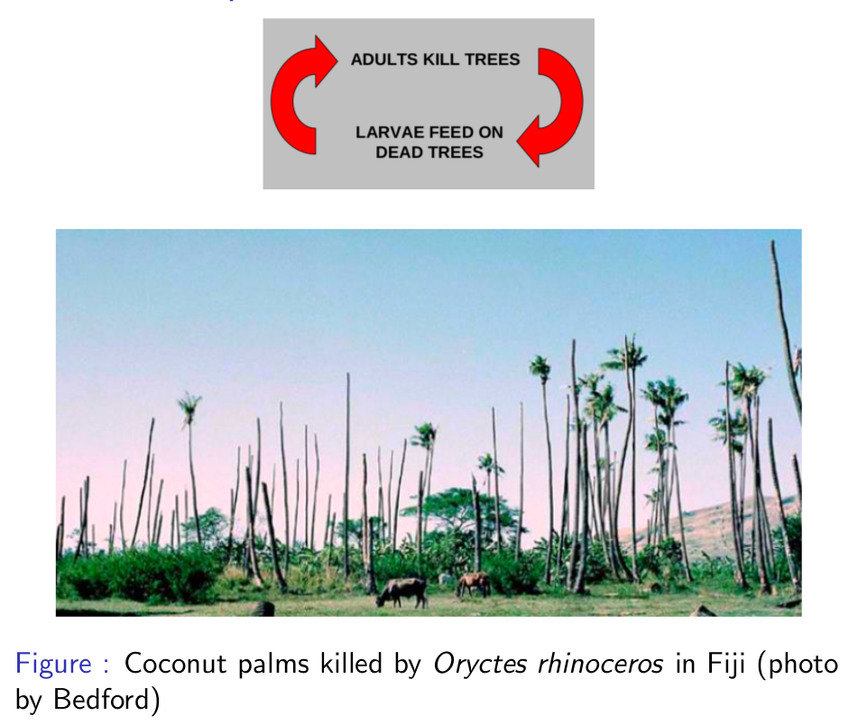

Slide 9
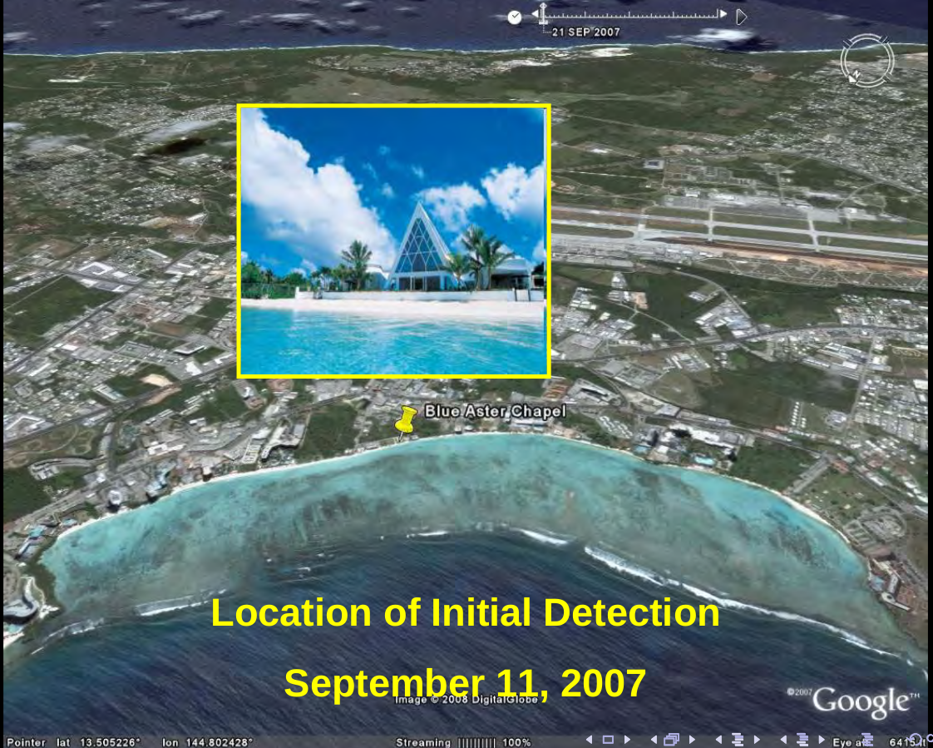

Slide 10
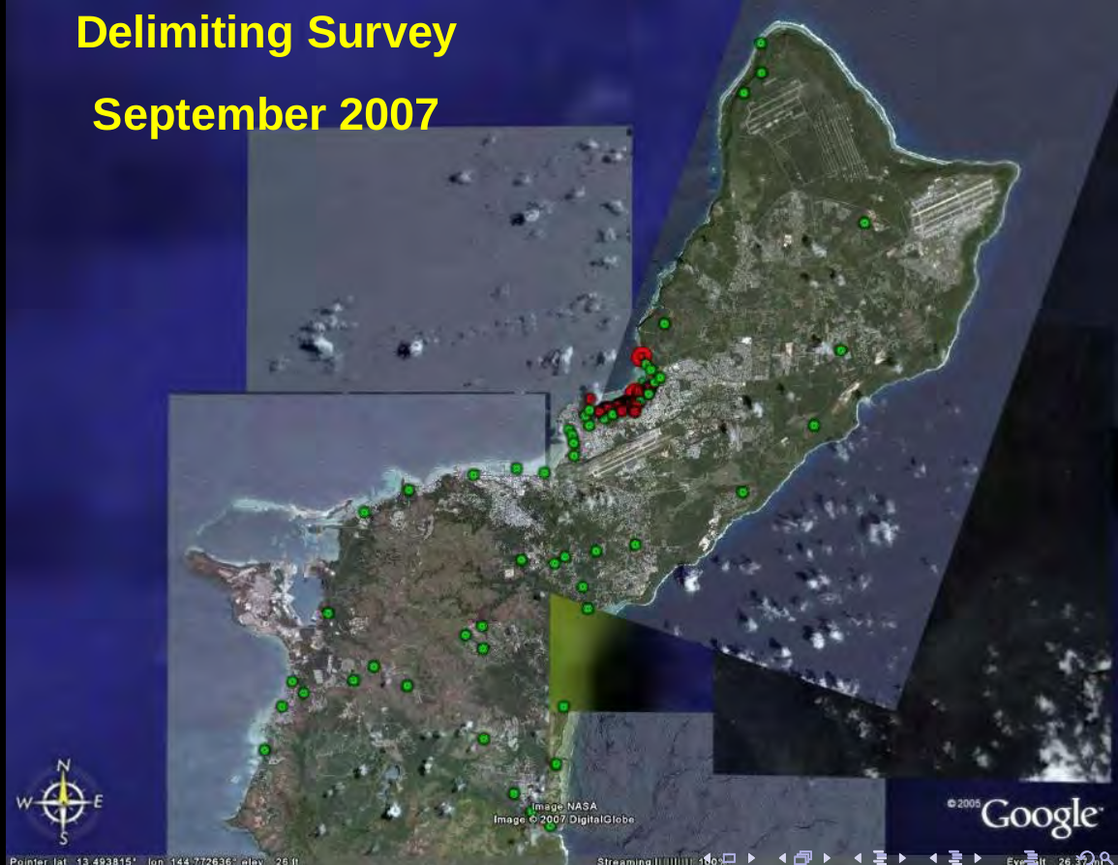

Slide 11
How to Eradicate CRB
Sanitation: Locate and destroy all active and potential breeding sites.
Quarantine: Close pathways to prevent re-introduction and accidental transport to uninfested areas.
Notes:
Eradication Tactics
trapping
quarantine
sanitation
chemical control
biological control

Slide 12
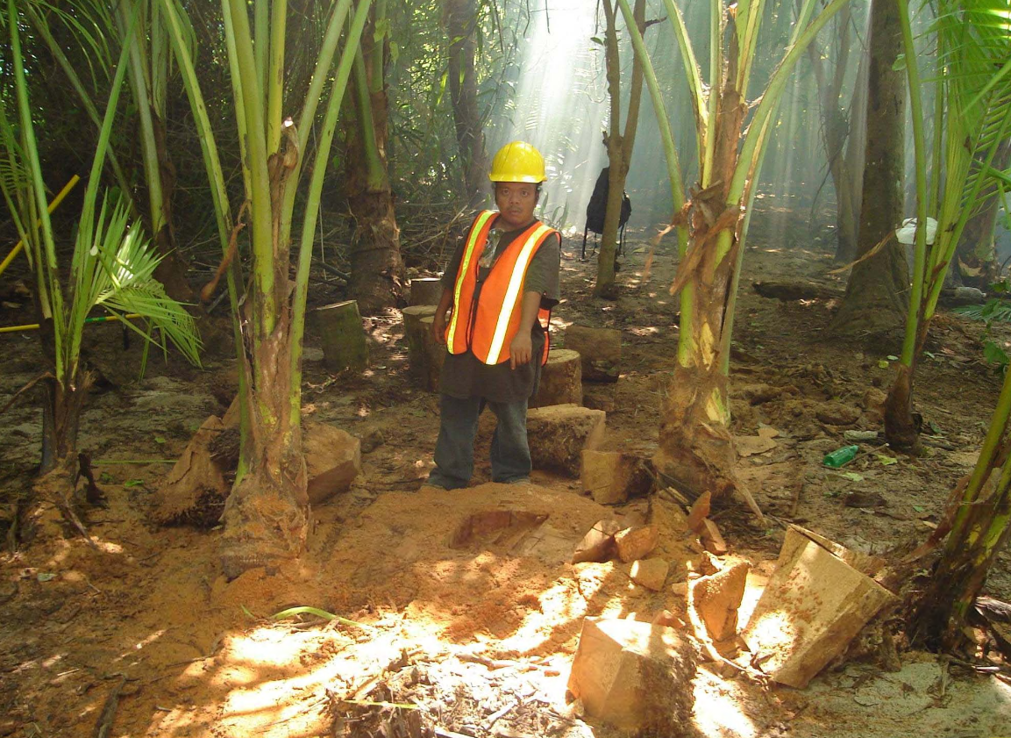

Slide 13
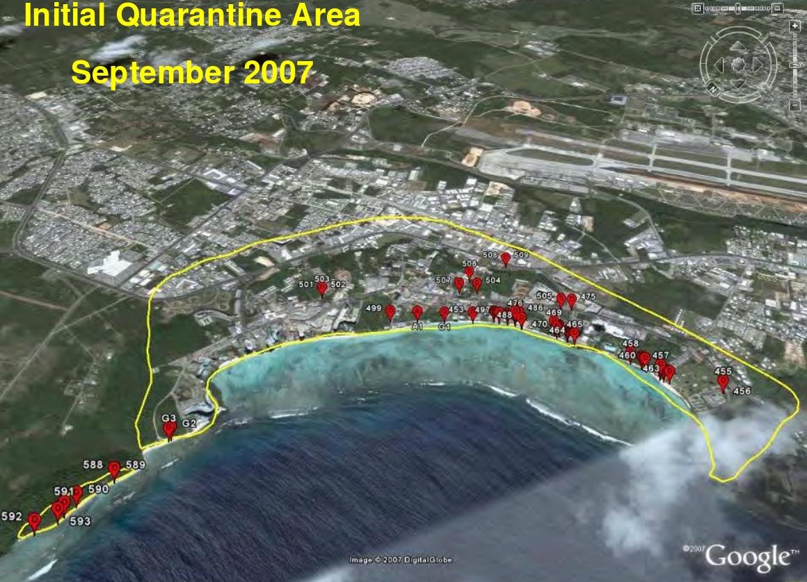

Slide 14
Additional CRB Control Tactics
Sanitation
Quarantine
Trapping
Chemical control
Biological control

Slide 15
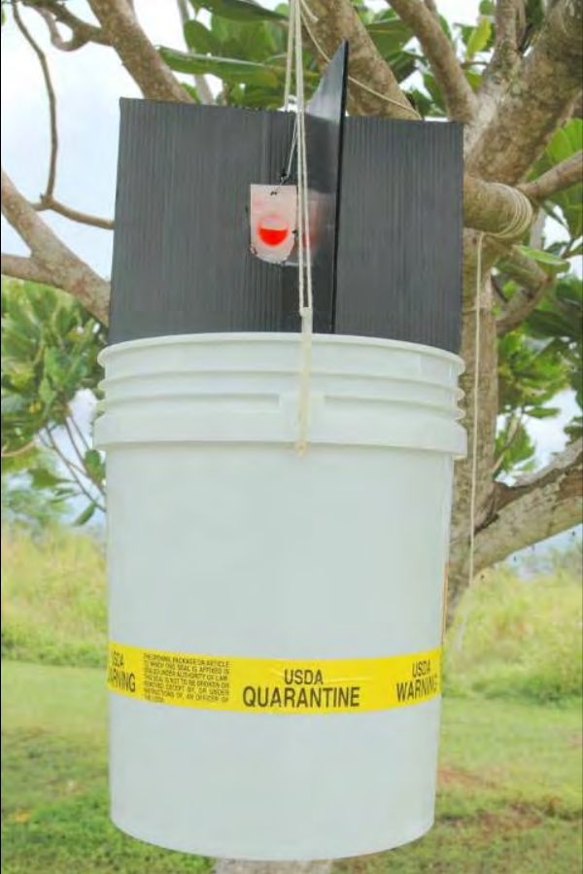
Trapping
Pheromone traps baited with oryctalure proved useless for population suppression
Pheromone traps are useful for detection and monitoring

Slide 16
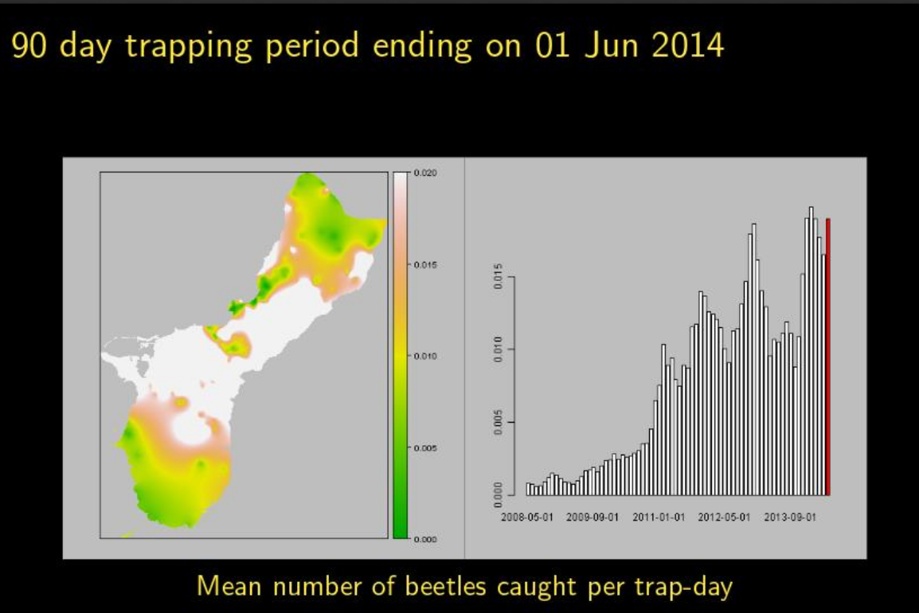

Slide 17
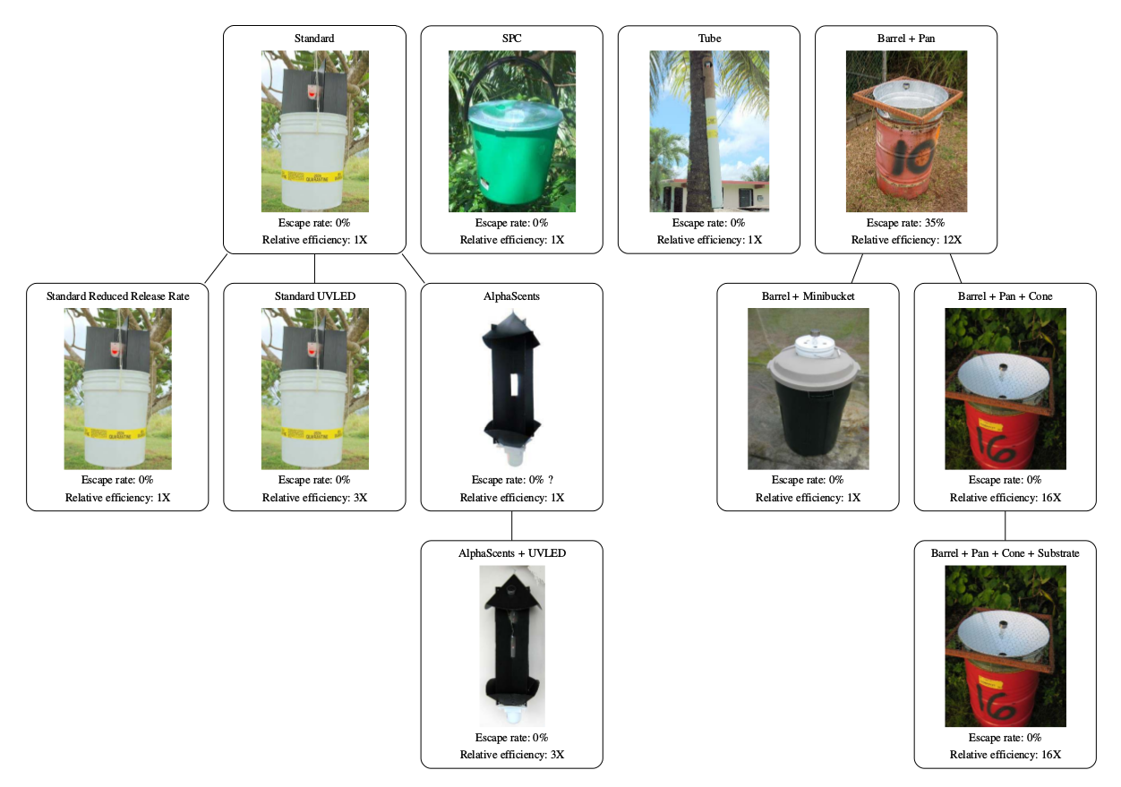
Pheromone Trap Development

Slide 18
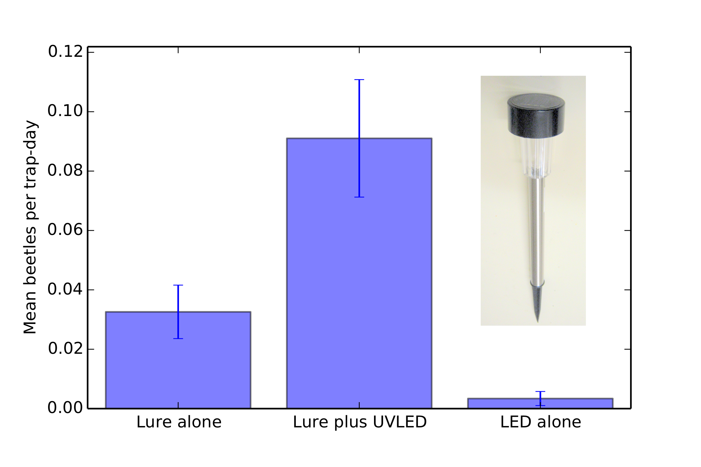
UV LED increases Trap Catch

Slide 19
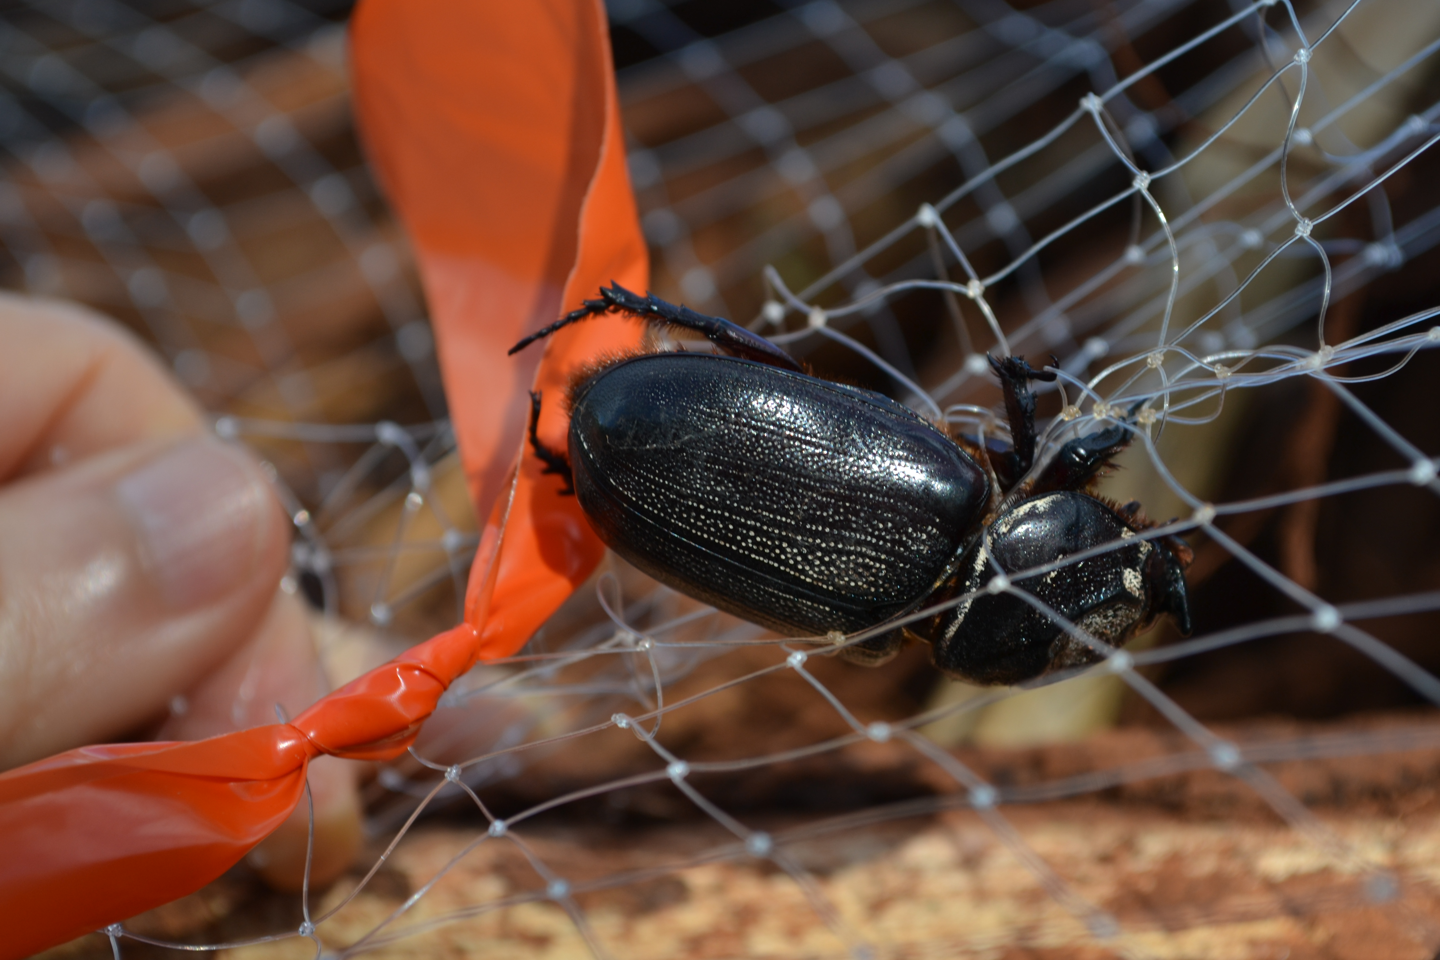
Tekken Trap

Slide 20
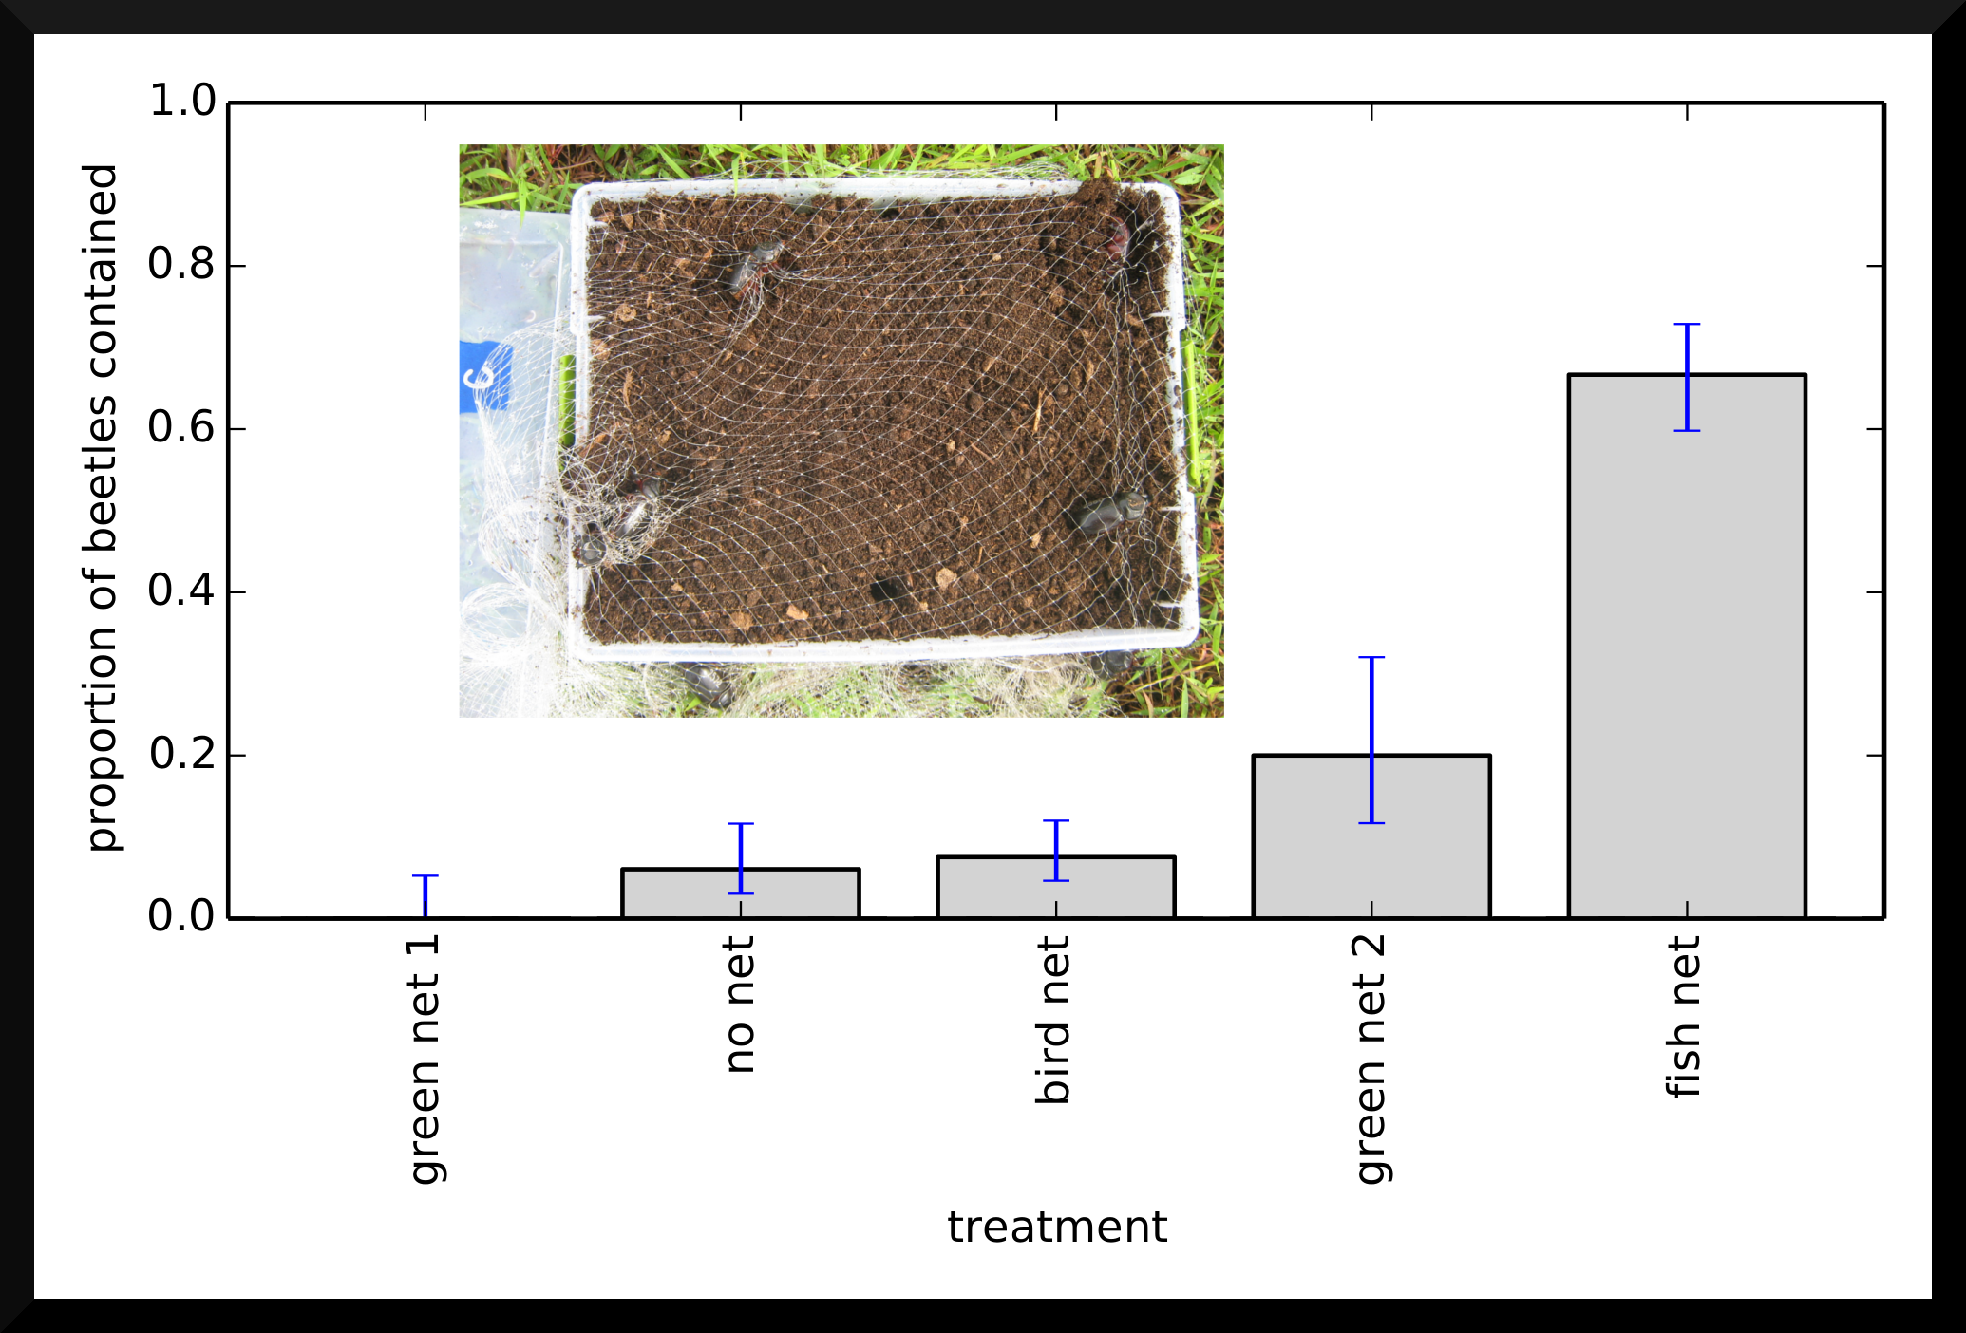
Tekken Trap

Slide 21
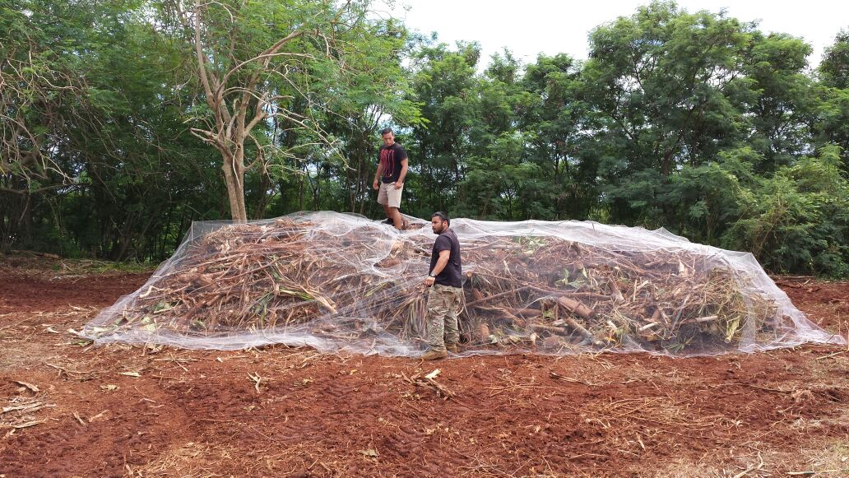
Tekken Trap

Slide 22
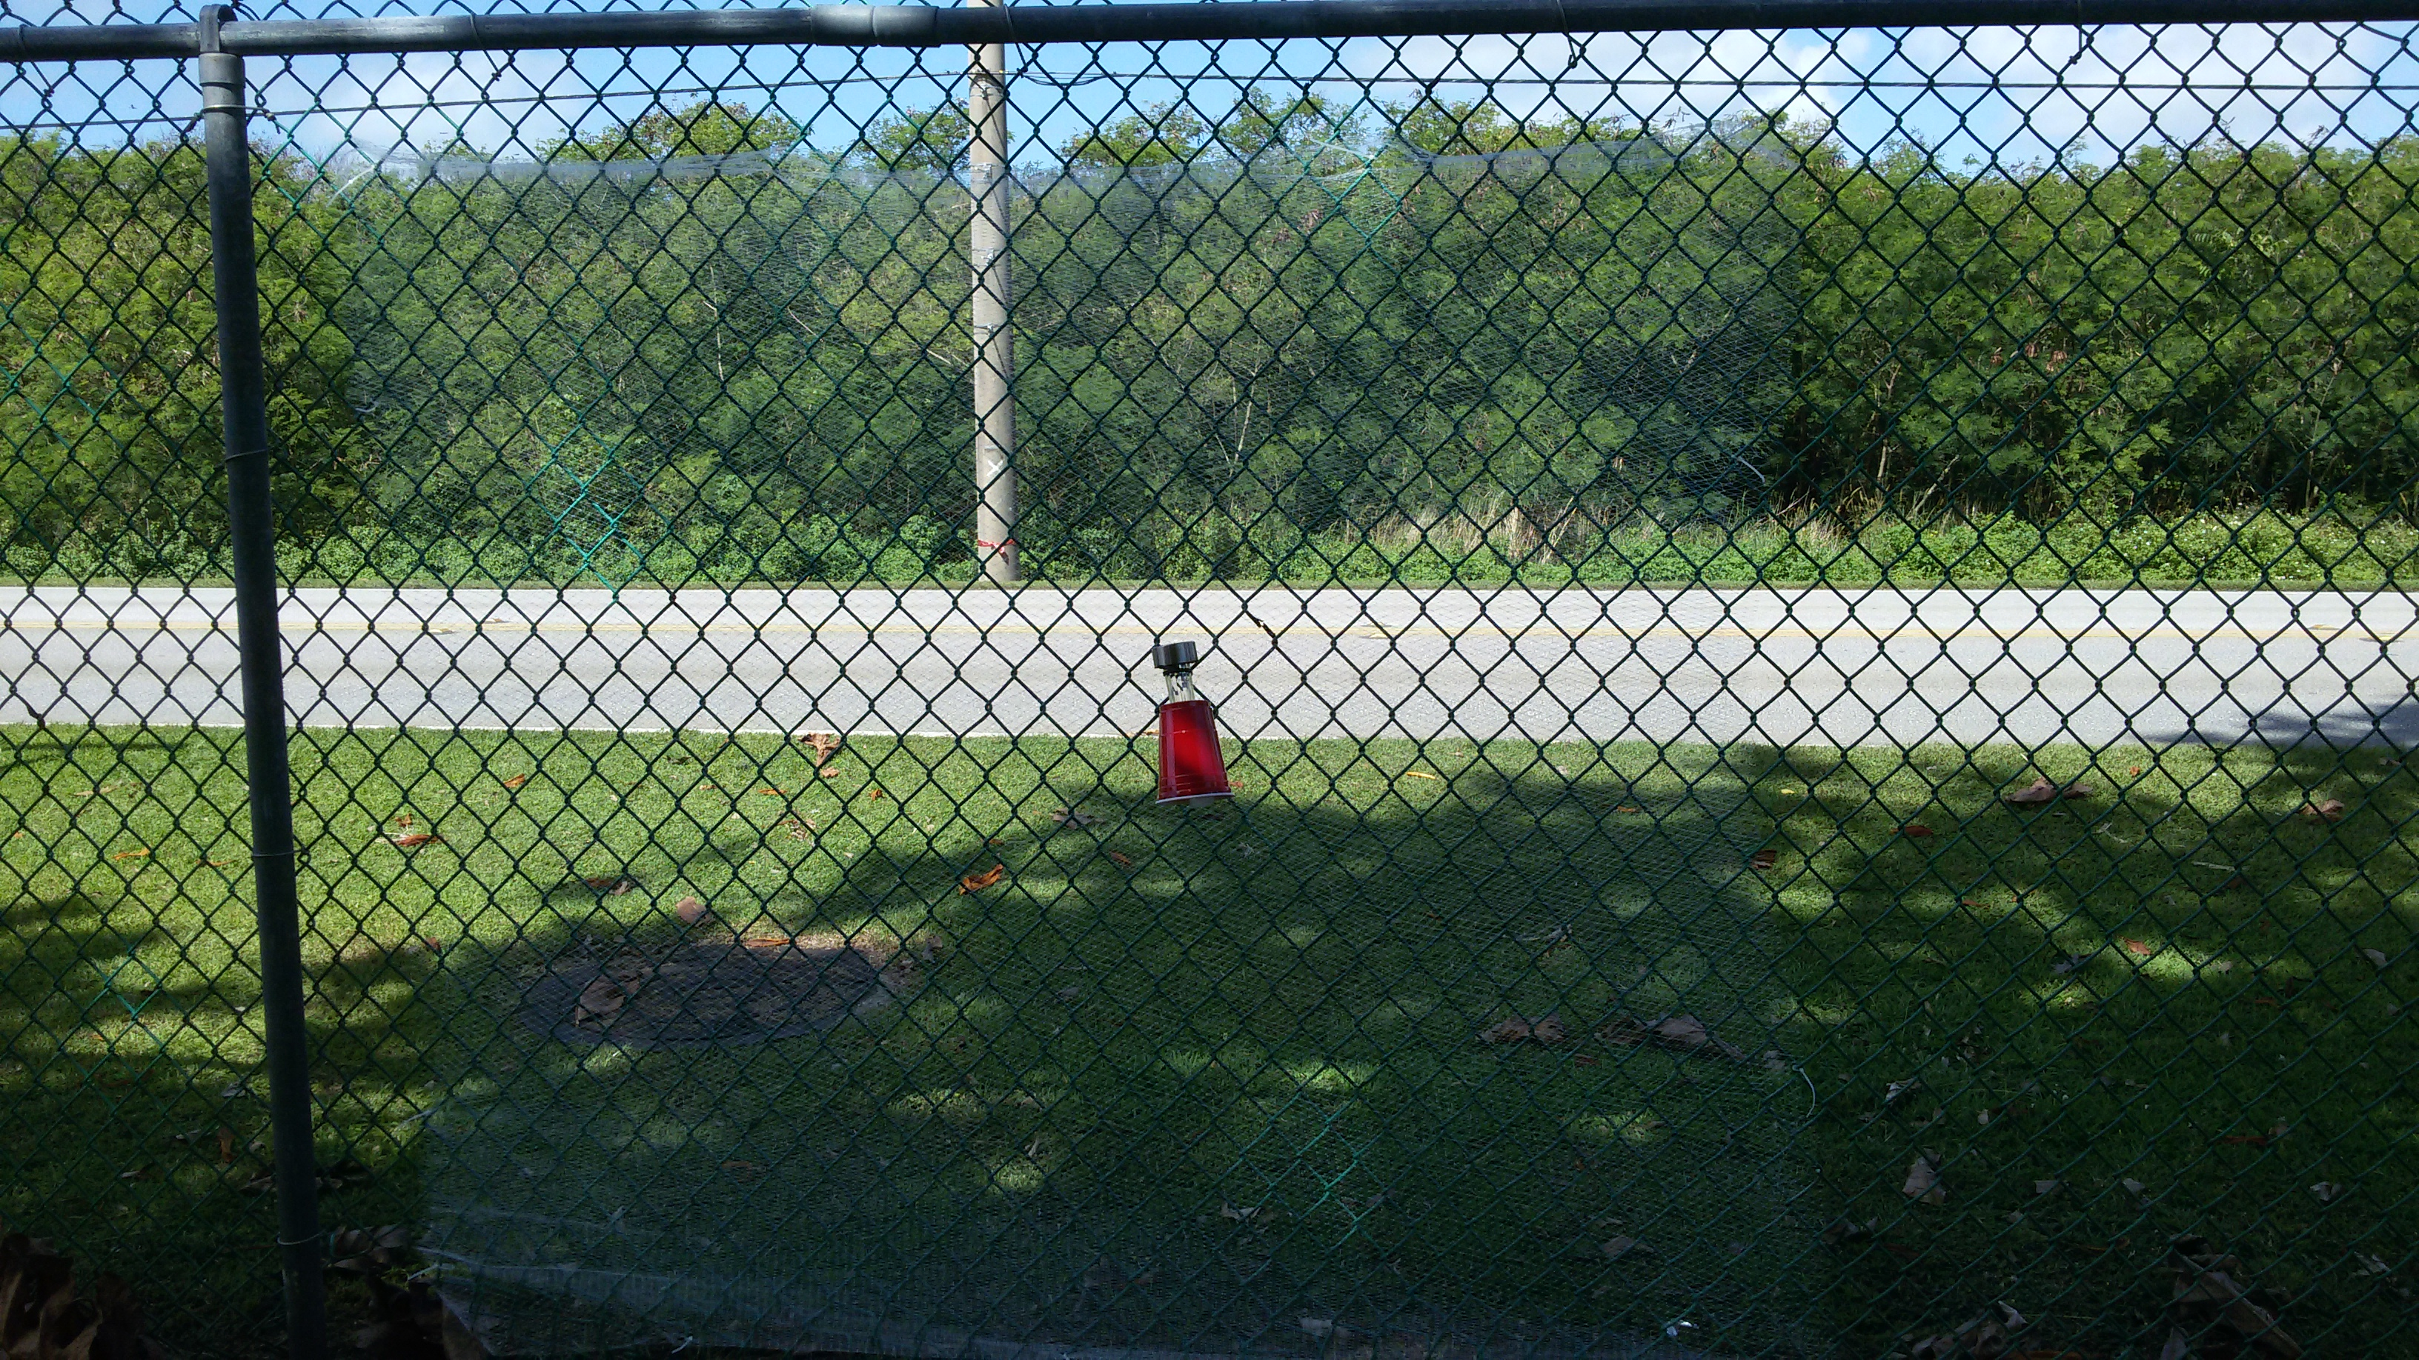
DeFence Trap

Slide 23
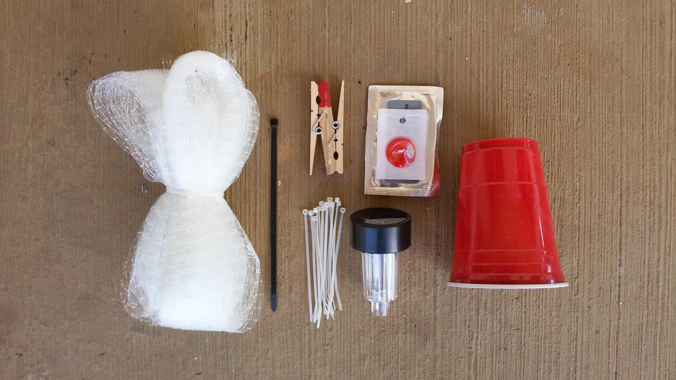
DeFence Trap

Slide 24
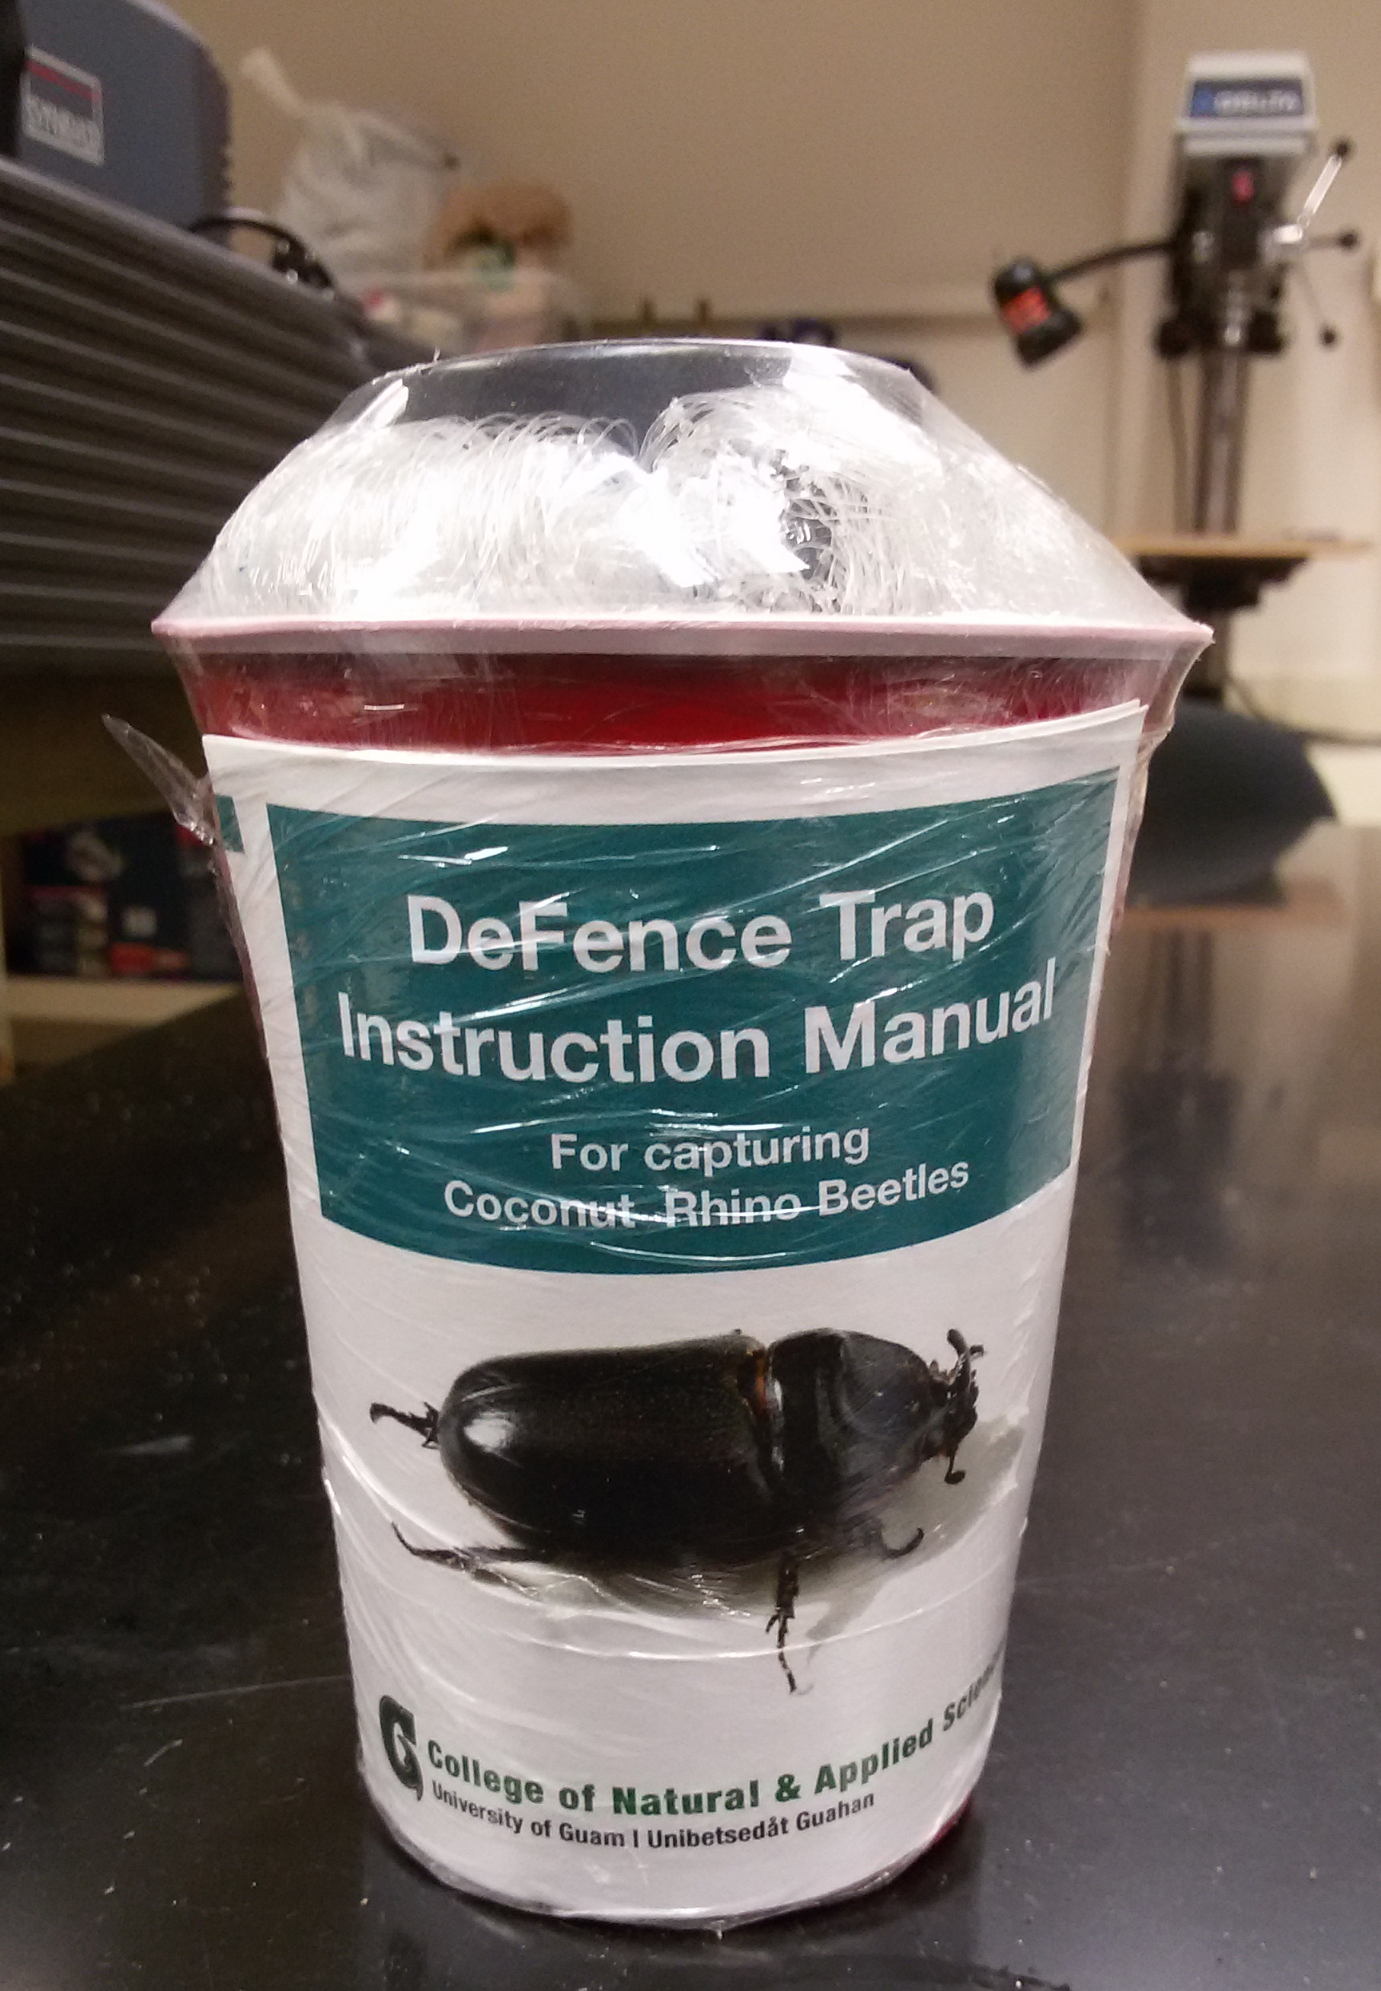

Slide 25
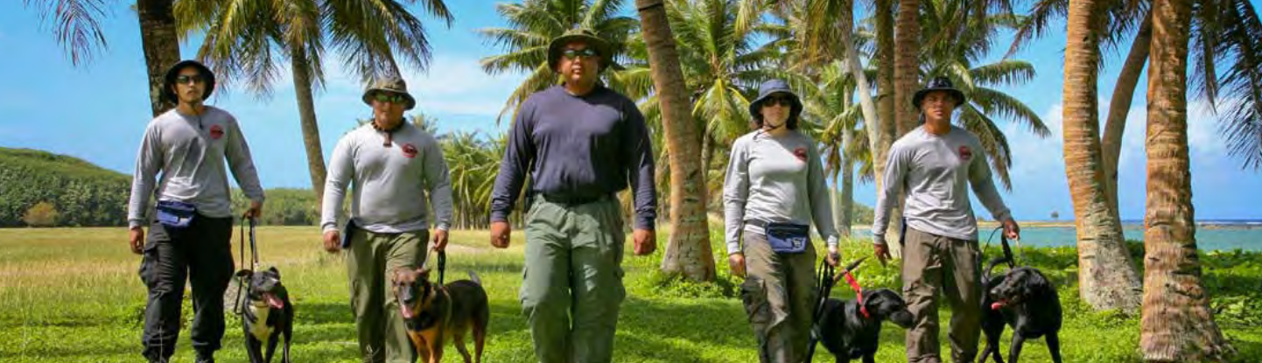
Detector Dogs for Locating Breeding Sites

Slide 26
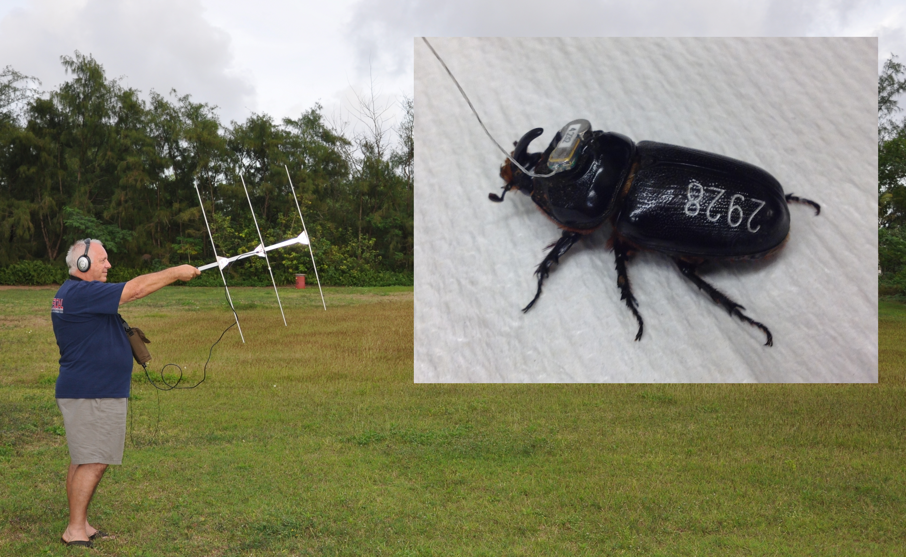
Detector Beetles for Locating Breeding Sites

Slide 27
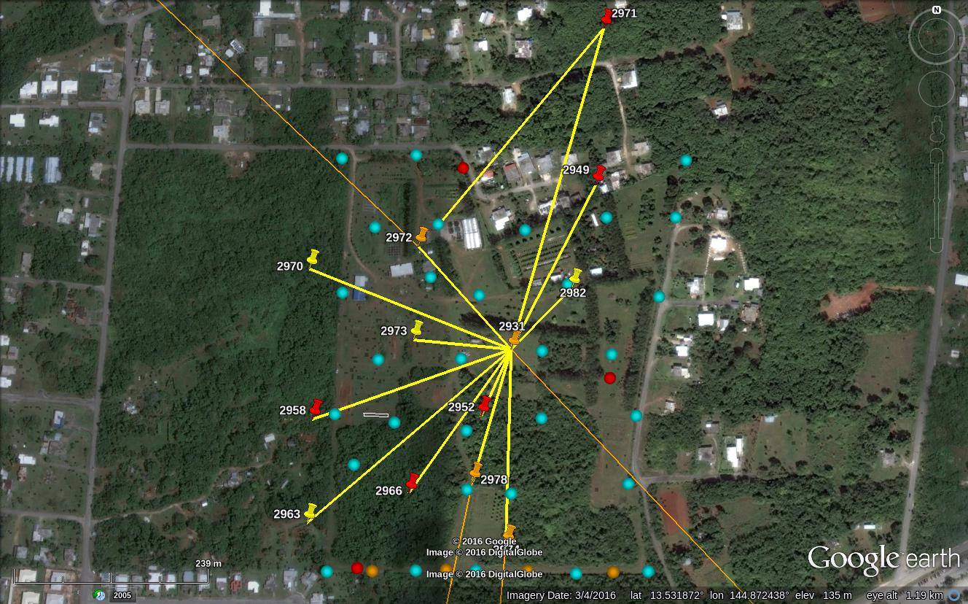
Detector Beetles for Locating Breeding Sites

Slide 28
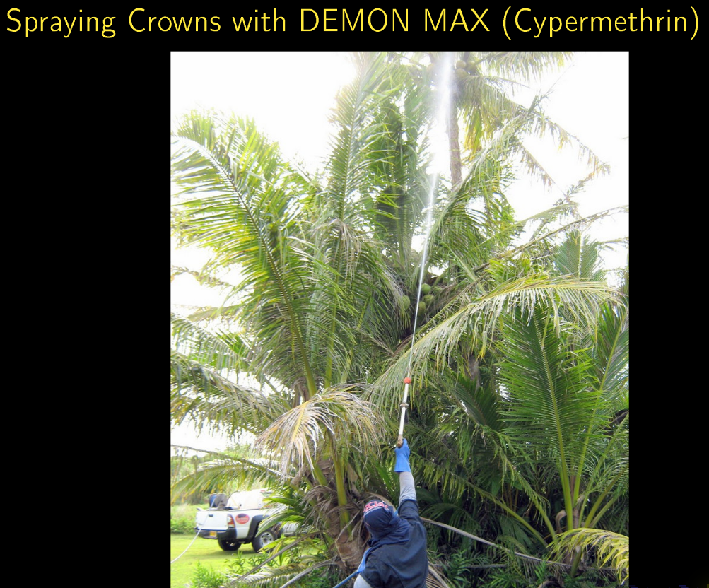
Chemical Control

Slide 29
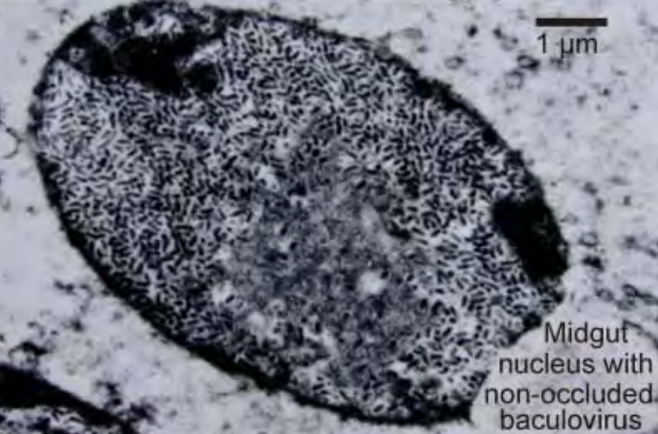
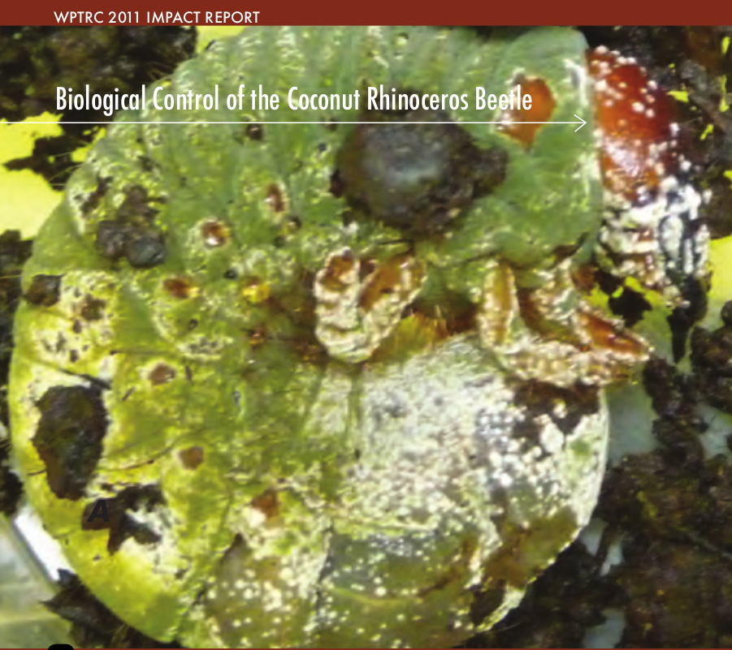
Biocontrol
Oryctes rhinoceros nudivirus (OrNV)
Green muscardine fungus (GMF)
Metarhizium majus

Slide 30
Discovery of the CRB-G Biotype
Marshall, Sean, Maclean Vaqalo, Aubrey Moore, Roland Quitugua, and Trevor Jackson (2015). A new invasive biotype of the coconut rhinoceros beetle (Oryctes rhinoceros) has escaped from biological control by Oryctes rhinoceros nudivirus.
Presented at the International Congress on Invertebrate Pathology and Microbial Control and the 48th Annual Meeting of the Society for Invertebrate Pathology, Vancouver, BC, August 2015.

Slide 31
Characteristics of CRB-G
genetically distinct
resistant to all available isolates of OrNV
more invasive (all 4 recent invasions involve CRB-G)
behavioral differences ???
not highly attracted to oryctalure
higher per-capita damage

Slide 32
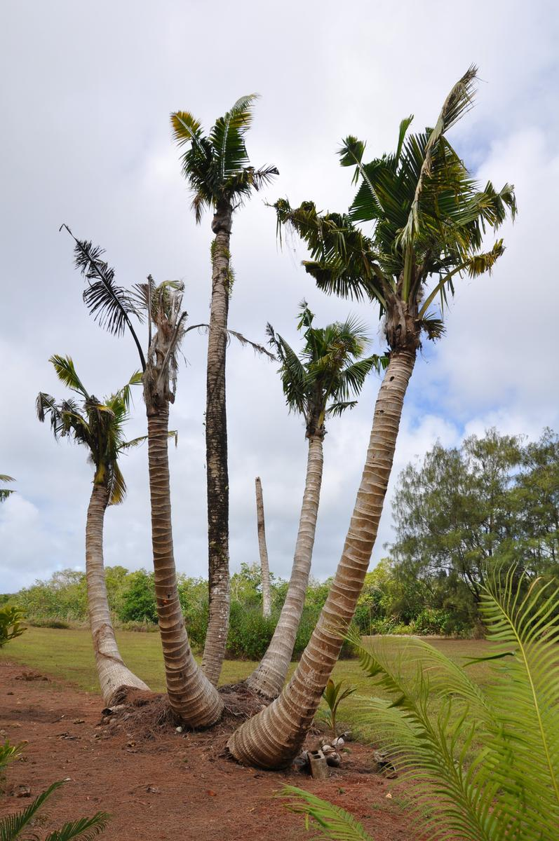
Current CRB Situation on Guam
An uncontrolled CRB outbreak is killing large numbers of coconut palms.

Slide 33
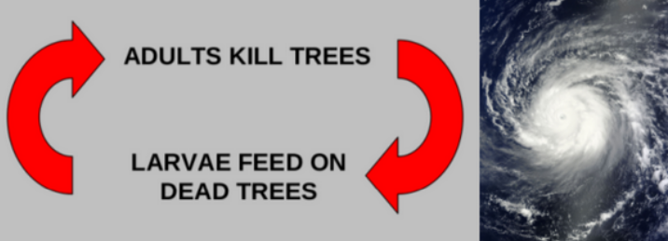
The current outbreak was triggered by Typhoon Dolphin which visited Guam in May 2015. Adult CRB emerging from abundant breeding sites where numerous to start killing mature coconut palms.
Dead standing coconuts are now generating further generations of CRB which are killing even more palms.

Slide 34
Current Prognosis for Guam
Current tactics of sanitation, trapping, application of Metarhizium may reduce local damage, but will do little to protect palms on an island-wide basis because most breeding sites are inaccessible (in jungle and/or on military bases).
Based on historical data from Palau and elsewhere, it is likely that Guam will loose 50% or more of its coconut palms.
Risk of accidental export of CRB to other islands is high.

Slide 35
What Can Be Done?
Effective biocontrol is probably our best chance of saving Guam's coconut palms on an island wide basis.
There is an urgent need to find an effective biocontrol agent for CRB-G. This will probably be an isolate of OrNV from an endemic CRB-G population in Asia.

Slide 36
CRB-G is a Regional Problem
Jackson, Trevor (2015). Need for emergency response for a new variant of rhinoceros beetle (Guam biotype). International Association for the Plant Protection Sciences Newsletter (XI). November, 2015. Available on-line at https://www.plantprotection.org/portals/0/documents/newsletters/2015/iapps%2011-2015.pdf
Vaqalo, Maclean, Sean Marshall, Trevor Jackson, Aubrey Moore (2015).
An Emerging Biotype of the Coconut Rhinoceros Beetle Discovered in the Pacific.
Secretariat of the Pacific Community, Land Resources Division. Available on-line at
http://www.spc.int/lrd/plant-health-publications/doc_download/2374-ph-agalertno51
Notes:
a
This OrNV resistant biotype has the potential to invade all cocconut growing areas,
including new islands and counties in SE Asia where CRB is naturally controlled by
OrNV. Efects on coconut and oil palm crops could be disasterous.
An emergency response to CRB-G is needed to minimize damage on newly invaded islands, thereby
reducing risk of further spread.

Slide 37
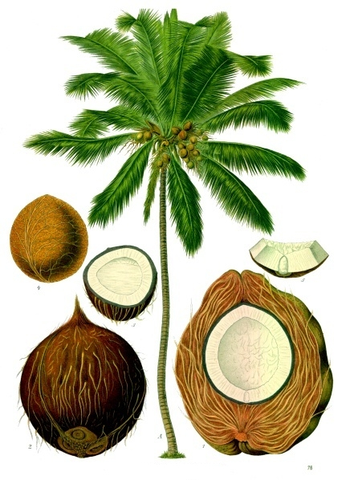
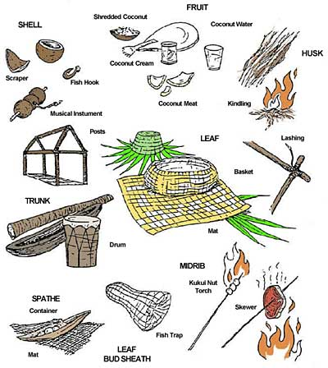

Slide 38
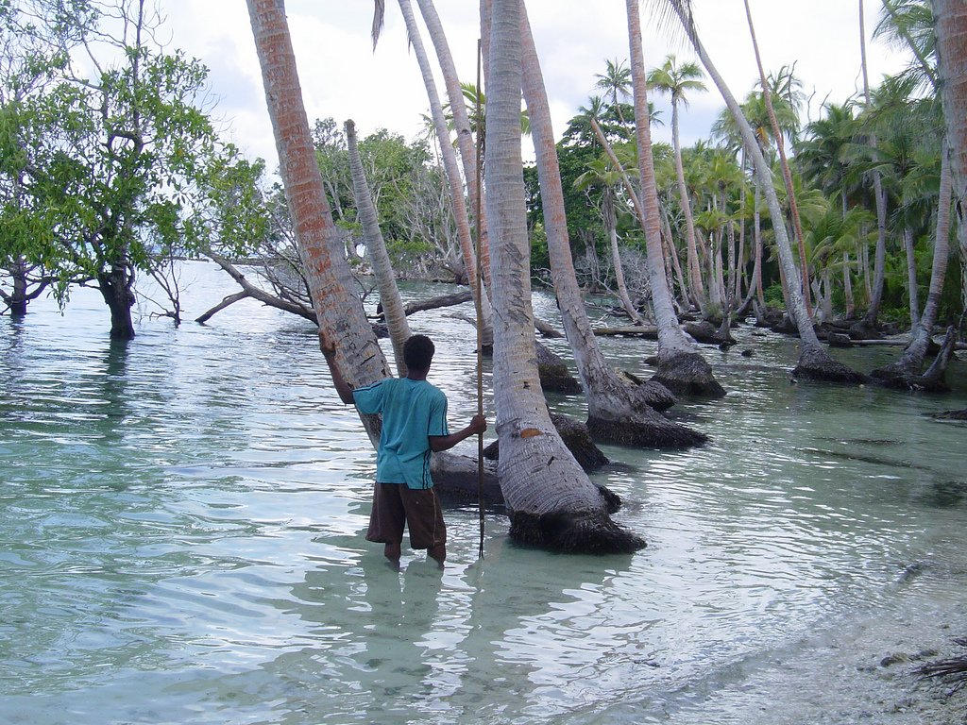
Link to Climate Change
Notes:
Sea level in the Solomons has risen 8 mm per year since 1993.

